Slide 1
Surveying And Reproducing MD5 Fast Collision Attack Algorithms
Hack Lab Presentation
Supervisor: Kaitai Liang
Meng Zheng
Electrical Engineering
M.Zheng-3@student.tudelft.nl
Yuhang Tian
Embedded System
Y.Tian-13@student.tudelft.nl
April 2021
Notes:
Good morning, I am Yuhang from the embedded system. We are a group consisting of two students. Another one is Meng from electrical engineering. Our topic is “Surveying and Reproducing MD5 Fast Collision Attack Algorithms” and our supervisor is professor Kaitai.

Slide 2
Overview
X. Wang’s Attacking Scheme
V. Klima’s Attacking Scheme
Collision Resistance
M. Stevens’ Attacking
Scheme
Comparison
Notes:
We have divided our presentation into 5 parts. Firstly, we will give brief background knowledge about collision attack. Then we will sequentially demonstrate the attacking methods. Finally, we will compare their features and performances.

Slide 3
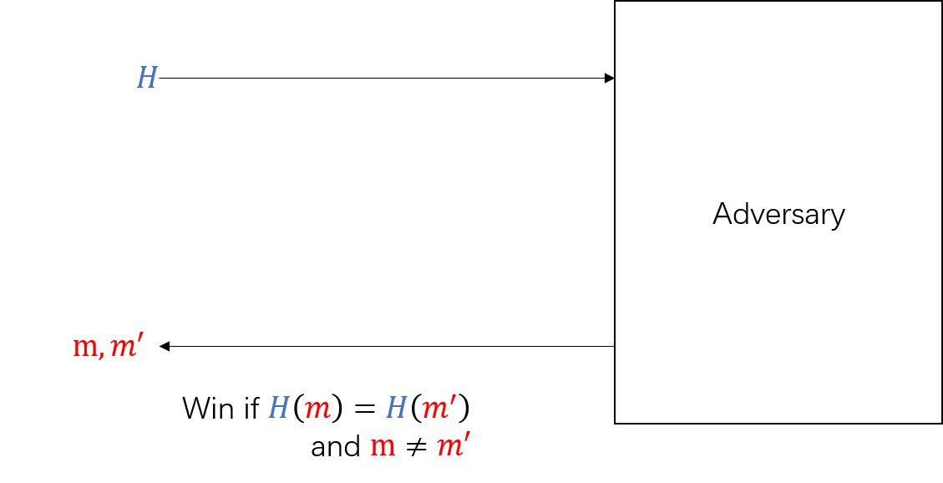
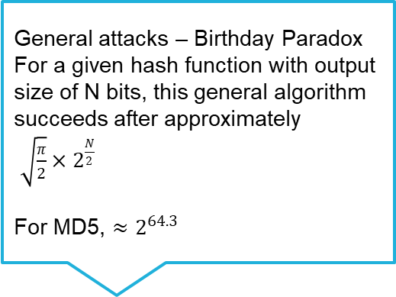
Collision Resistance & Collision Attack
A hash function should have the collision resistance – it is infeasible to find two messages that have the identical hash values
Notes:
So, what is a collision attack? Given a hash function, if someone can generate two messages that have the same hash digests, then we can say she/he finds a collision. Many attacks for achieving collision are based on the birthday paradox. That is “for a given hash function with output size of N bits, the attacker needs this number of trials in theoretical to find one collision”. For MD5, the output is 128 bits, so it needs to try about two to the power 64.3 times, which is inefficient.

Slide 4
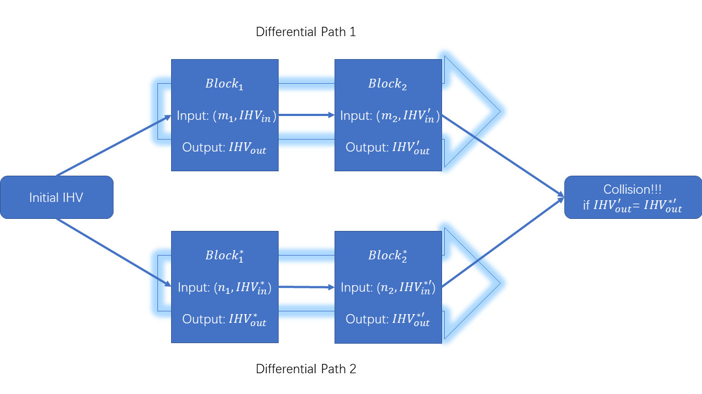
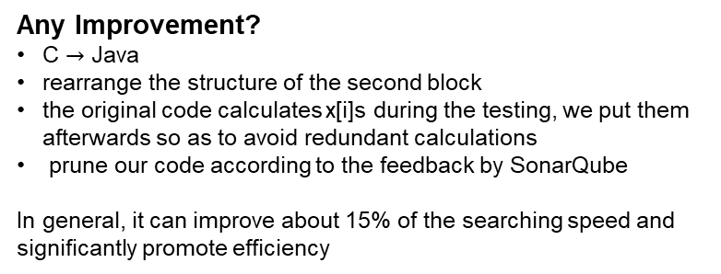
Wang’s Collision Attack – Differential Path & Message Modification
Message Modification:
When a certain condition in the second round fails, one can use message modification. This is a substitution formula specially made for this condition on the message block B. In the case that this condition does not hold applying this substitution has the effect that this condition now does hold without interfering with other previous conditions.
Notes:
The first efficient method was invented by Xiaoyun Wang in 2004. She used differential path and message modification to find collision pairs. The core idea of message modification is when a certain condition in the second round fails, one can use message modification to make it stratifies the condition without interfering with other previous conditions. The original coding language is C, and we use Java to reproduce it. In addition, the original structure of the second block is blurry, so we rearrange the structure to make it more sensible. Besides, the original code calculates x[i]s during the testing, but it is not necessary. We put them afterwards so as to avoid redundant calculations. In general, it can improve about 15% of the searching speed and significantly promote efficiency. Furthermore, we also prune our code according to the feedback by SonarQube which can automatically analyze the quality of the code and give suggestions for tuning. The next scheme is provided by Marc Stevens which is explored by my teammate, Meng. So, he will give more details about it in the next section.

Slide 5
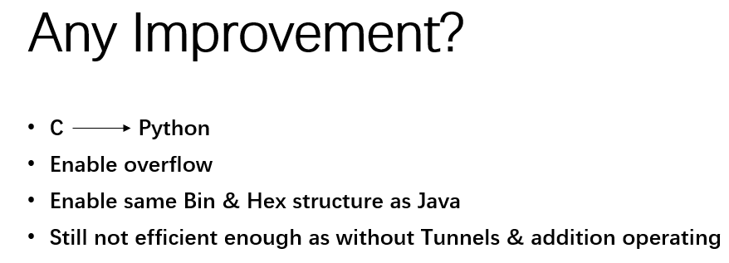
Marc Stevens’ Fastcoll Attack
MD5 backward & optimized sufficient requirements
Collision happens deterministically
Random Q fullfill conditions
Calculate Message using MD5 backward:
Judging other optimized conditions
Without Tunnels
Notes:
However Marc Stevens proposed paper pointed out that Wang’s sufficient conditions are not sufficient at all, in another word, even all conditions meet in Wang’s attack, collision happens probably, so here, Marc Steven provided an attack ensure collision happens deterministically. This is achieved by adding optimized sufficient conditions and MD Five backward. Here we provided some of the key points of this attack.
First instead of doing forward MD five, this method generate random Q that fulfill optimized sufficient conditions, then using MDfive backward equation, which is shown below to calculate corresponding message. Then by applying Q one to Q sixteen and message zero to message fifteen with MD5 forward, we can calculate corresponding following Qs, in this way, if any following Q not satisfy optimized conditions, repeat the random process.
This attack ensure a deterministic collision, however it did not apply Tunnels which will be introduced in the next part of presentation.
So, any improvement?
Well I must say yes, but not obvious, first of all, we reproduced this work in Python, as Bin and Hex structure in Python and JAVA or even C are quite different, it is really a hard work. Secondly, as python did not have overflow, we also enabled overflow in Python, to make sure each bit in Q is correct, we also enabled same Binary and Hex structure with Java and C. However this method is still not efficient enough as it applied without using Tunnels, also we need additional operating with overflow and Binary and Hex structure.

Slide 6
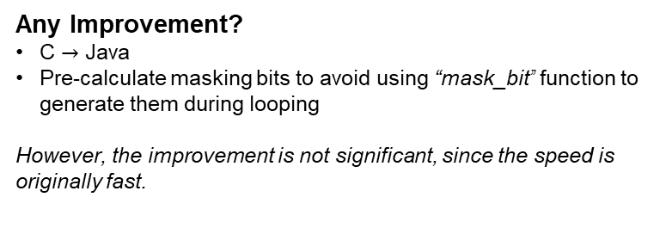
Klima’s Collision Attack – Point of Verification (PoV) & Tunnels
The Deterministic and Probabilistic Tunnels
The modification is more flexible
Tunneling enables to fast collision searching and in some sense replace present multi-message modification methods considerably.
Notes:
In terms of Klima’s collision attack, he uses Point of Verification which structure is more flexible compared to message modification’s one. Therefore, it can get the result much faster. The original coding language is C, and we use Java to reproduce it. In his code, he uses the function ”mask bit” to generate the masking bits based on the step conditions. However, we think this function is not efficient, as the masking bits are commonly used among the tunnels, so it is redundant and unnecessary to call it every time when using it, especially in the loops. Thus, we calculate them before running the program. However, the improvement is not significant, since the speed is originally fast.

Slide 7
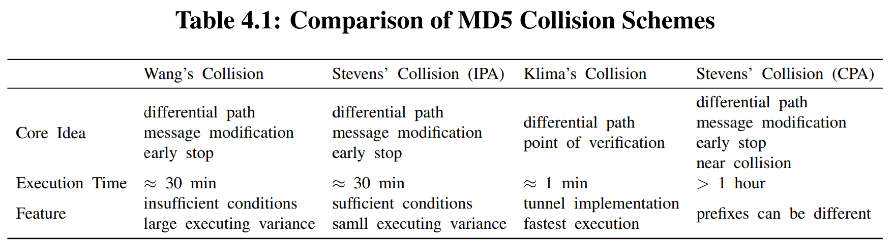
Comparison
Due to the insufficient conditions, Wang’s searching sometimes meaninglessly traverses Q[20], which adversely increases the worst-case execution time.
The searching time of Stevens’ attack tends to be more stable.
The fast algorithm to find a collision pair of MD5 is the one provided by Klima equipped with tunnels.
Stevens’ versions are fancy that can choose the prefix or even use a single block to obtain the collision, but the trade-off is spending more time.
Notes:
Next, we make a table to compare their performances. According to the table, we can induce the followings. Firstly, Due to the insufficient conditions, Wang’s searching sometimes meaninglessly traverses Q[20], which adversely increases the worst-case execution time. Secondly, the searching time of Stevens’ attack tends to be more stable. In other words, the variance is lower compared to Wang’s one, because the sufficient conditions optimize the worst-case execution time. Thirdly, the fastest algorithm to find a collision pair of MD5 is the one provided by Klima equipped with tunnels. It often costs less than 2 minutes to find a collision pair, due to the flexibility of tunnel implementation. However, the PoV only increases the probability of searching the satisfied values, so it needs forward MD5 testing after each block. Finally, Stevens’ versions are fancy that can choose the prefix or even use a single block to obtain the collision, but the trade-off is spending more time.

Slide 8
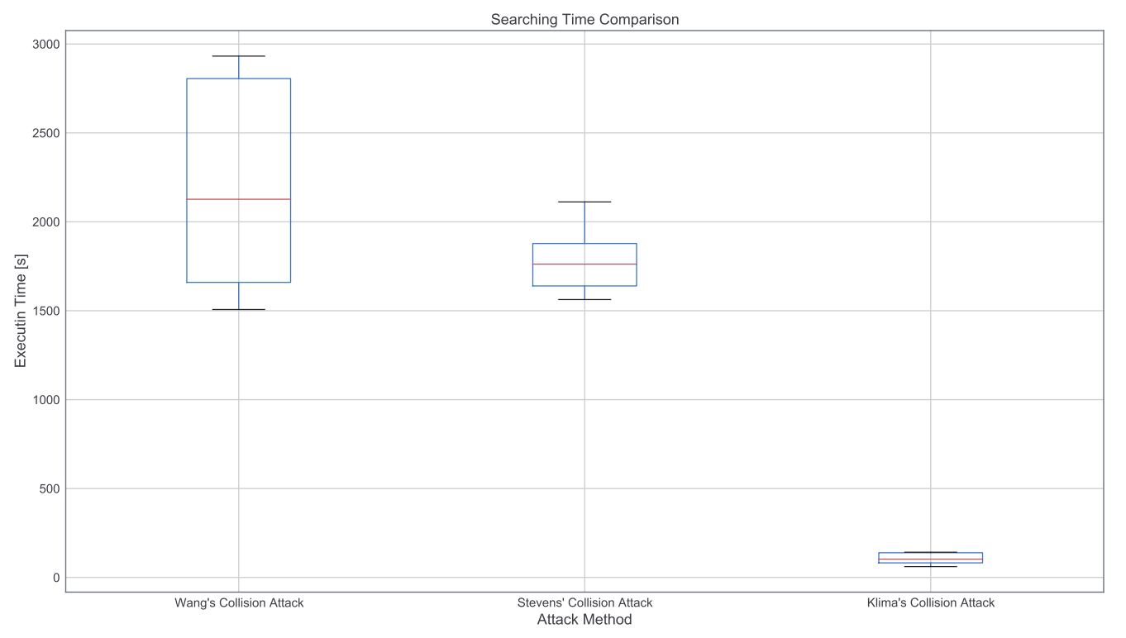
Comparison
Figure 4.1: Box-plot Comparison
Notes:
To make audiences visually and directly get the differences between their searching performances, we draw a box-plot to visualize the result. It should be mentioned that the repetition of experiments is 10. According to the figure, the scheme invented by Klima wins the fast speed. The core ideas of Wang’s searching scheme and Stevens’ are almost the same, so their performances are similar, but Stevens uses sufficient conditions that improve the worst-case execution time to some extent. Therefore, in general, Stevens’ implementation is better than Wang’s original version.

Slide 9
Thanks for your listening!
Questions?
Project Website: https://github.com/Timo9Madrid7/MD5-Collision
Notes:
That is the end of our presentation, we are welcome to answer any questions if you have. Thanks for your listening.

Slide 10
Reference
Stevens, M., Lenstra, A. K., & De Weger, B. (2012). Chosen-prefix collisions for MD5 and applications. International Journal of Applied Cryptography, 2(4), 322-359.
Stevens, M. (2012). Attacks on hash functions and applications. Mathematical Institute, Faculty of Science, Leiden University, 3.
Stevens, M. (2006). Fast Collision Attack on MD5. IACR Cryptol. ePrint Arch., 2006, 104.
Wang, X., & Yu, H. (2005, May). How to break MD5 and other hash functions. In Annual international conference on the theory and applications of cryptographic techniques (pp. 19-35). Springer, Berlin, Heidelberg.
Klima, V. (2006). Tunnels in Hash Functions: MD5 Collisions Within a Minute. IACR Cryptol. ePrint Arch., 2006, 105.
Klima, V. (2005). Finding MD5 Collisions on a Notebook PC Using Multi-message Modifications. IACR Cryptol. ePrint Arch., 2005, 102.
Hawkes, P., Paddon, M., & Rose, G. G. (2004). Musings on the Wang et al. MD5 Collision. IACR Cryptol. ePrint Arch., 2004, 264.
Smart, N. P., & Smart, N. P. (2016). Cryptography made simple. Springer.
Mikle, O. (2004). Practical Attacks on Digital Signatures Using MD5 Message Digest. IACR Cryptol. ePrint Arch., 2004, 356.
Kaminsky, D. (2005). MD5 to be considered harmful someday. In Aggressive Network Self-Defense (pp. 323-337). Syngress.
Kashyap, N. D. (2006). A meaningful MD5 hash collision attack.

